Slide 1
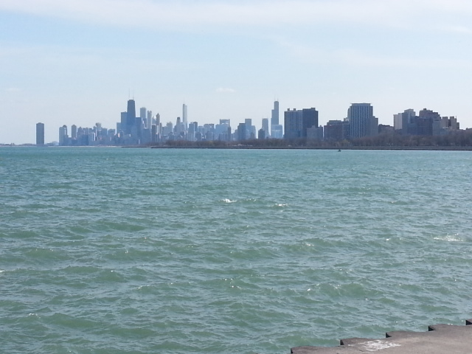
Certified Hazardous Material Manager (CHMM)
3-Day Overview Course $595
June 13 – 16, 2016
DePaul University McGowan South Room 401
1110 W. Belden Avenue Chicago, IL 60614
Contact: Margaret Workman
DePaul University
mworkman@depaul.edu
773-325-7445
http://margaretworkman.weebly.com/chmm-course-information.html
Offered By:
DePaul University Dept. of Environmental Science & Studies
in cooperation with the
Chicago Chapter of the Alliance of Hazardous Materials Professionals
and
Gabriel Environmental Services

